Slide 1

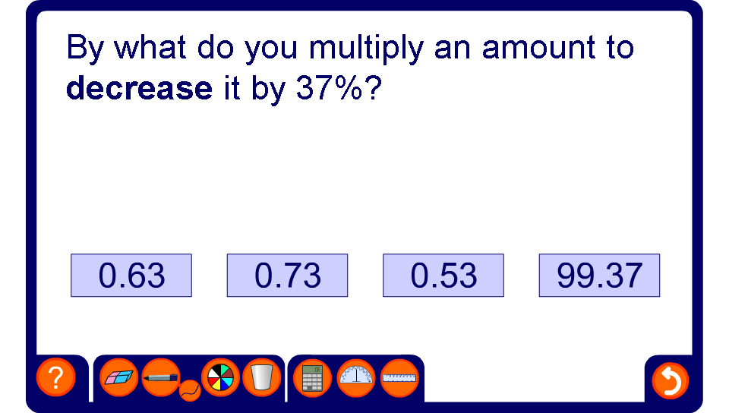


Percentage increase and decrease

